Slide 1
Xiaoyu Lin Dec 9. 2021
Covid-19 Confirmed Cases
& Incidents of Crime
in Hartford. CT

Slide 2
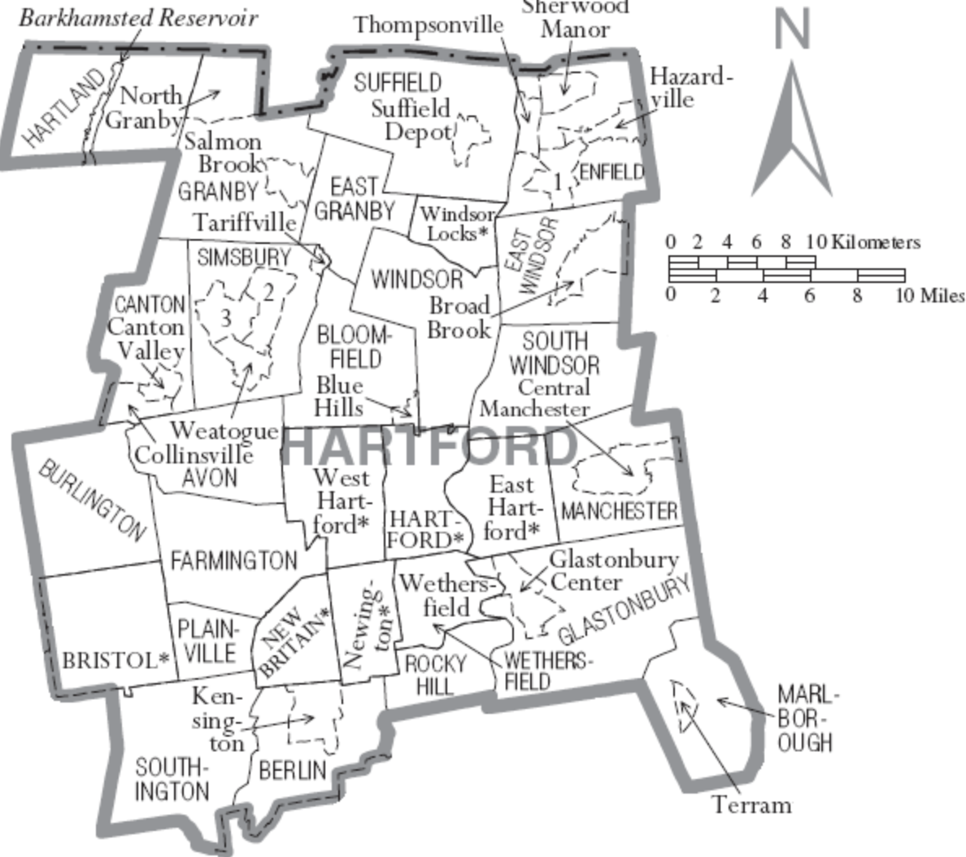
Introduction
Motivation
“stay-at-home orders implemented globally due to the Covid-19 pandemic were associated with a 37% decrease in average crime rates in 27 cities in 23 countries”
by Nature Human Behavior
Whether this finding would also apply to mask mandate in Hartford, CT?
The safety and crime rate of an area are critical to the quality of life of local people
Goals
Explore the impact of Covid-19 mask mandate on local security and whether there is a correlation between the two factors.
Apply and practice human-centered data science.

Slide 3
Problem Statement
During the implementation of the mask mandate in Hartford, CT, is there a correlation between Covid-19 Confirmed Cases and Incidents of Crime?
After experiencing the implementation of the mask mandate, whether Hartford's crime rate was lower than that of the same period in previous years?
Is there any difference in the impact of the implementation of mask mandate on the number of crime in different regions of Hartford.
Is there any difference in the impact of mask mandate on the number of crime in different categories.

Slide 4
Dataset & Method
Data Sources
Mask Mandates by County from CDC https://data.cdc.gov/Policy-Surveillance/U-S-State-and-Territorial-Public-Mask-Mandates-Fro/62d6-pm5i)
Crime Incidents of the City of Hartford https://data.hartford.gov/Public-Safety/Police-Incidents 01012005-to-Current/889t-nwfu
Covid-19 Cases by Town, Connecticut https://data.ct.gov/Health-and-Human-Services/COVID-19-Tests-Cases-and-Deaths-By-Town-/28fr-iqnx
Methodology
Python - Data Mining & Processing
Tableau - Data Visualization
R - Statistic Tests:
- Correlation Test
- Hypothesis Testing

Slide 5
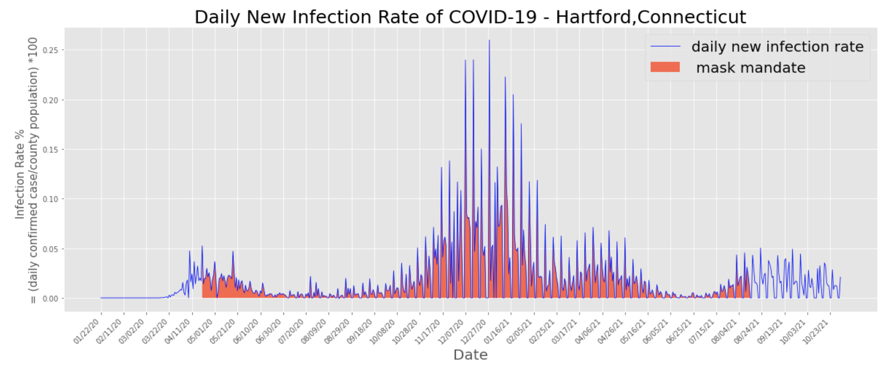
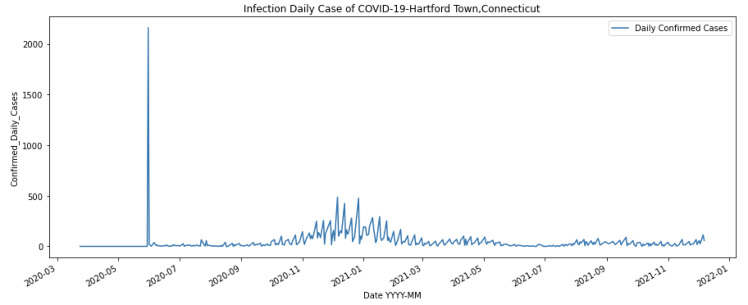
Overview of Covid-19 Confirmed Cases - Hartford County vs. Hartford City , Connecticut
Mask Mandate Period
April 20,2020 – August 15,2021
Outlier: May 31, 2020
2161 cases
Research will focus on
June 1, 2020 – May 31, 2021
2020-05-31
2161 cases

Slide 6
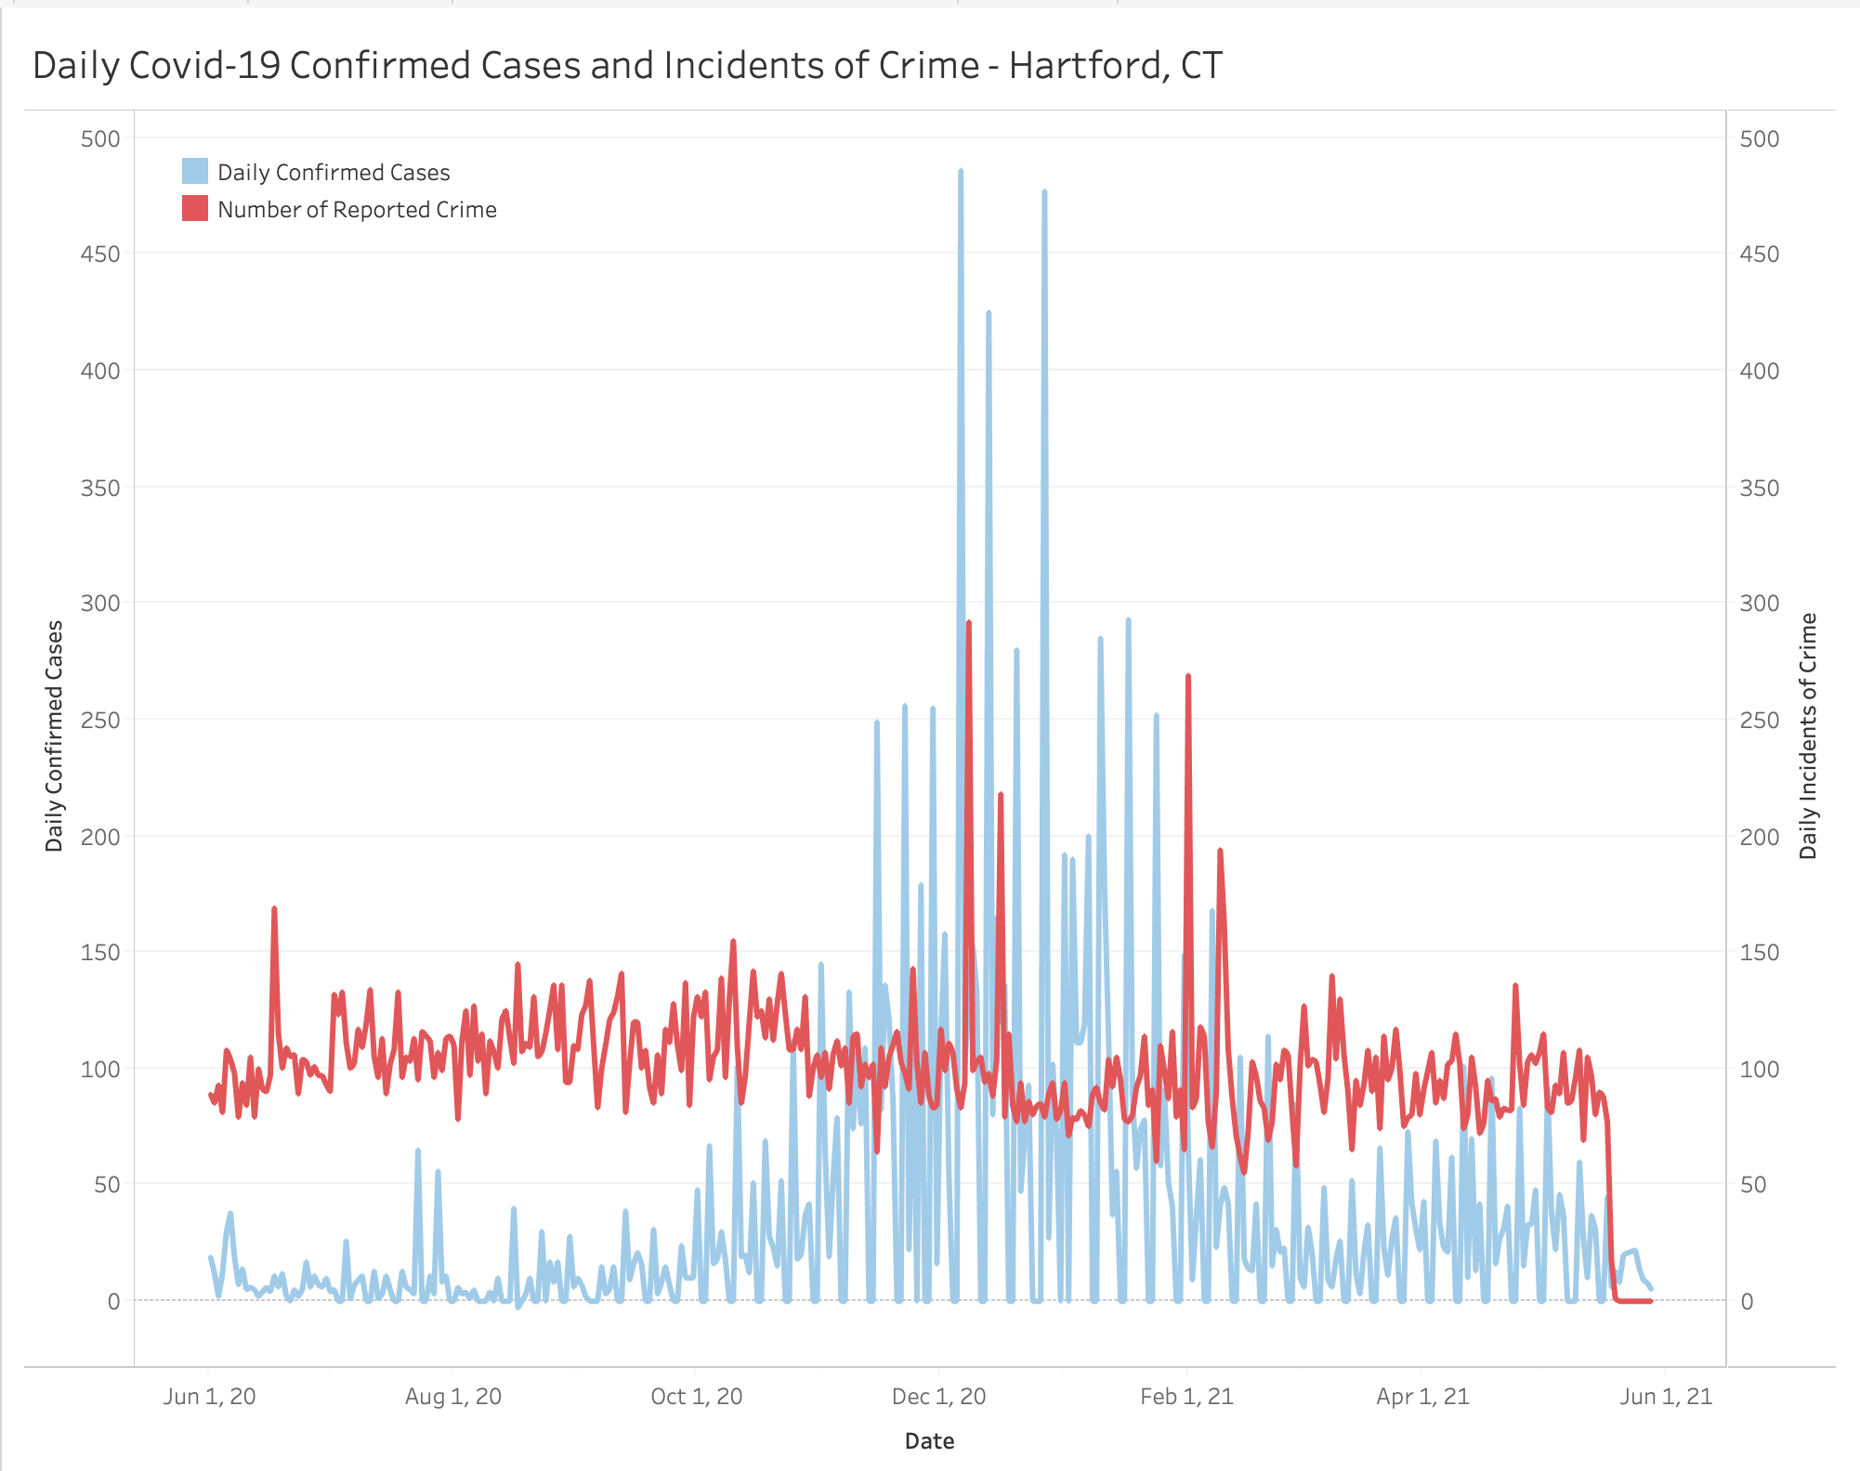
Correlation between Covid-19 Confirmed Cases and Incidents of Crime
Large fluctuations during November 2020 and February 2021 at the same time
Correlation Test:
- correlation coefficient (Cor.coeff = -0.089)
- 95% confidence interval
(-0.191 0.015)
- p-value - 0.092

Slide 7
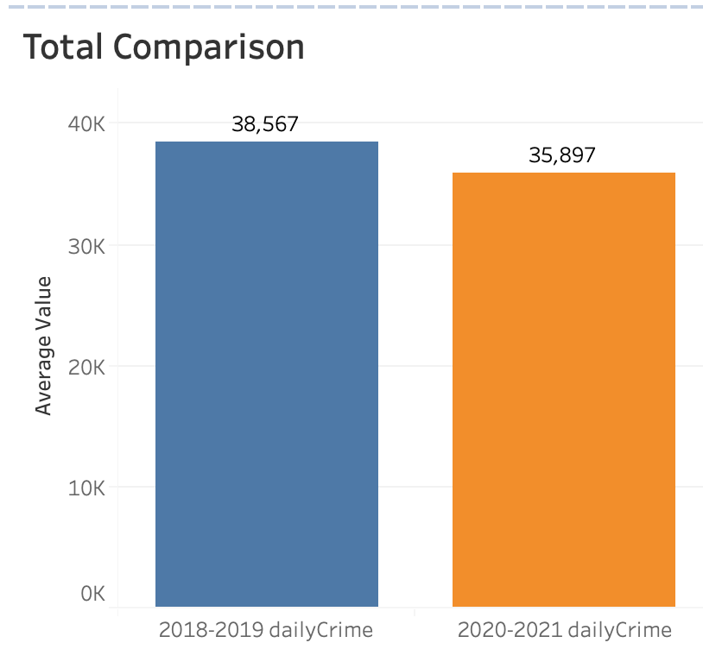
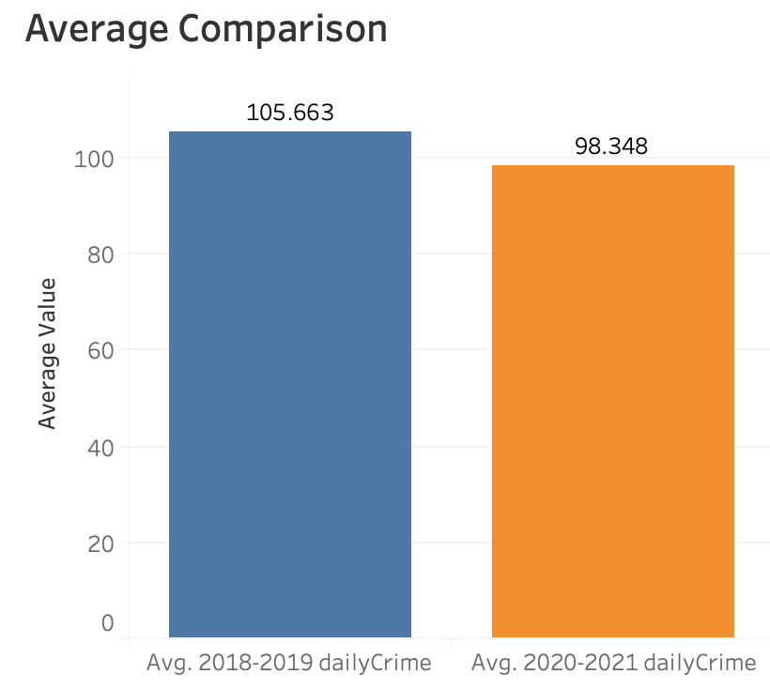
Comparison of the Number of Crimes : 2020.06~2021.05 VS. 2018.06~2019.05
On Total: - 2,670
On Average: -7.315
Hypothesis Test
- Null Hypothesis:
μ(2020～2021) = μ(2018～2019)
- Alternative Hypothesis:
μ(2020～2021) < μ(2018～2019)
Z-score : -3.663
p-value : 0.450
Confidence Interval (95%)
(-11.230 ~ -3.401)
Difference does exist
But not significant

Slide 8
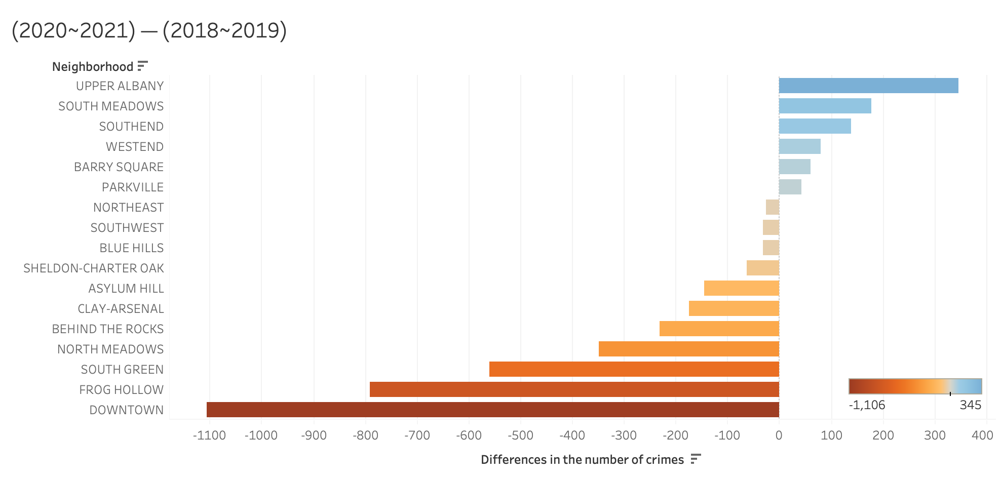
Comparison of the Number of Crimes by Regions: 2020.06~2021.05 VS. 2018.06~2019.05
The number of crimes has decreased in most regions (11/17)
Regions with the most significant reduction in the number of crimes
- Downtown (-1106)
- Frog Hollow (-792)
- South Green (-560)
Regions with the most significant increase in the number of crimes
- Upper Albany (345)

Slide 9
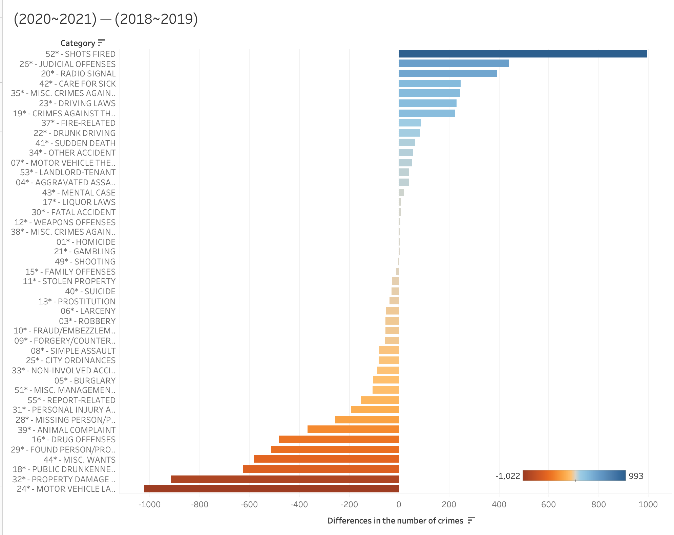
Comparison of the Number of Crimes by Categories: 2020.06~2021.05 VS. 2018.06~2019.05
The number of crimes has decreased in most categories (24/43)
Categories with the most significant reduction in the number of crimes
- Motor Vehicle Law (-1022)
- Property Damage Accident (-917)
Categories with the most significant increase in the number of crimes
- Shots Fired (993)

Slide 10
Conclusion
During the implementation of the mask mandate in Hartford, there was no significant correlation between the number of crimes and the number of Covid-19 confirmed cases.
Both the number of crimes and confirmed cases fluctuated more significantly between November 2020 and February 2021
There is indeed a difference in the number of crimes before and after the Covid-19 pandemic , but it is not significant
The number of crimes has decreased in most regions and categories

Slide 11
Limitation & Further Research
Comparison with the average of the past five or ten years will make the study more rigorous
The number of crimes can be affected by many factors, such as unemployment rate, triggers of special social events, etc. The potential impact of these factors cannot be ruled out in this study
Future research will continue to explore the impact of stay-at-home orders on the number of crimes, particularly the first phase of the policy.

Slide 12
Thanks!
Any questions?

